Slide 1
Clubs on Congress Restoration July 2017
CONFIDENTIAL REVIEW

Slide 2
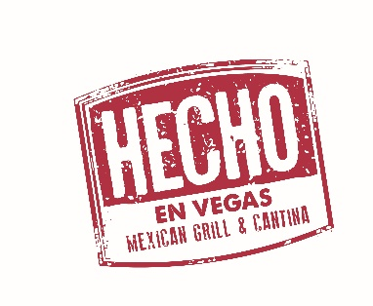
Who is Flores Concepts?
Flores Concepts is a retail and wholesale hospitality management and creative development firm based in Tucson, AZ.
A family owned business, Flores Concepts’ food and beverage roots date back to 1922 when Monica Flin, the family’s great aunt, founded the original El Charro Café in Tucson, AZ.
Flores Concepts owns, operates, and has developed over a dozen food and beverage concepts in Arizona, Nevada, Michigan, California and more ranging in specialties from restaurants and bars to full service catering and USDA licensed food manufacturing.
We proudly employ nearly 400 local crew members in the Tucson area
Flores Concept affiliated brands include the following:
© 2017, FLORES CONCEPTS, LLC

Slide 3
Clubs on Congress Restoration
Flores Concepts has negotiated and secured the purchase of three highly visible
street front locations on Congress in Tucson, AZ.
The venues currently known as Zen Rock, H20, and The Betty Gay space will be
re-developed and operated by a division of Flores Concepts or a strategic affiliate.
Based on their many years of downtown business experience;
Flores Concepts will study and develop new and vibrant concepts to install into the three aging spaces in order to bring more sales diversity to the current retail and entertainment mix downtown.
The Three Locations Under Contract Are:
121 E. Congress Street
61 E. Congress Street
125 E. Congress
© 2017, FLORES CONCEPTS, LLC

Slide 4
How did we get here?
While once very successful businesses, the Zen Rock and Sapphire/H2O clubs were pioneers and critical elements in the rebirth we see today of Congress Street as an entertainment hub.
They were part of the first wave of businesses to take the risk others were waiting to make and open up on the west side of the street, long before the development of the new and more trafficked east side and the work of today’s Rio Nuevo leadership that solidified Congress as Tucson’s business development hot spot.
As things change in retail and entertainment, a lot has also changed along Congress in the last 5 years; so with only one of the three storefronts having a viable business enterprise, the owner approached Flores Concepts to buy all three of the highly visible downtown locations. The previous owner, aware of the need to evolve and invest with the progress and new developments along Congress; was not interested in doing so and began the search for a buyer. The part time Tucsonan no longer wanted to operate retail businesses in Arizona and has decided to sell the controlling interest in all three properties to a division of Flores Concepts.
The owner recognized that the Flores Concepts Family are more than just another restaurant family; they are the perfect group to take over the reigns of these highly visible properties as they have maintained a retail presence in Downtown Tucson longer than most anyone else and have an extraordinary passion for this community.
Flores Concepts is diverse, capable, and forward thinking and believe they have the team and talent to re-develop and restore these wonderful Congress street fronts and store locations into businesses of distinction, prosperity and longevity for all to be proud of and enjoy.
© 2017, FLORES CONCEPTS, LLC

Slide 5
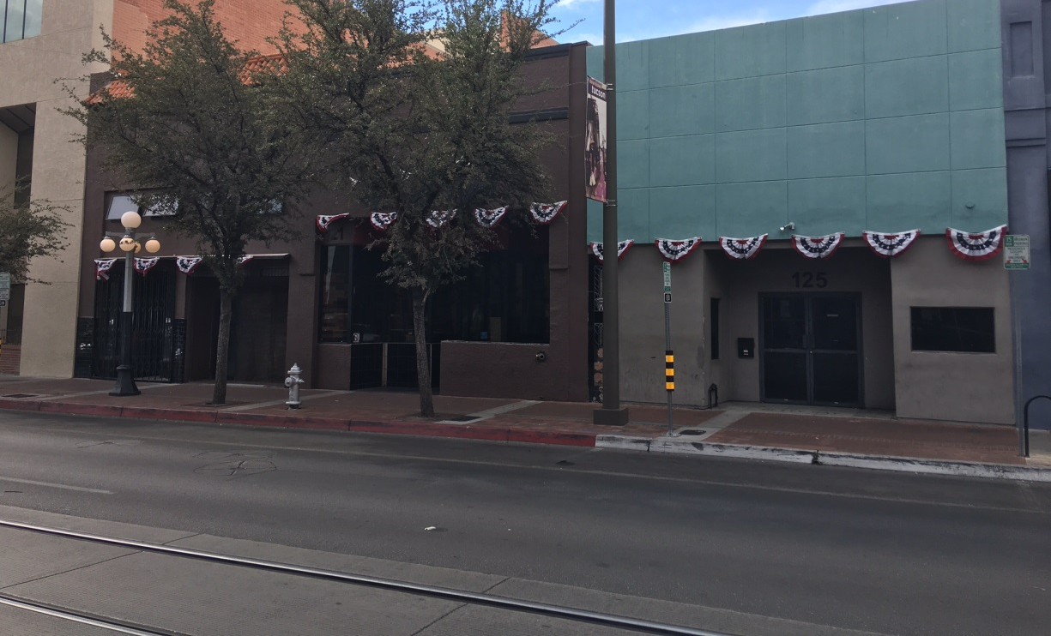
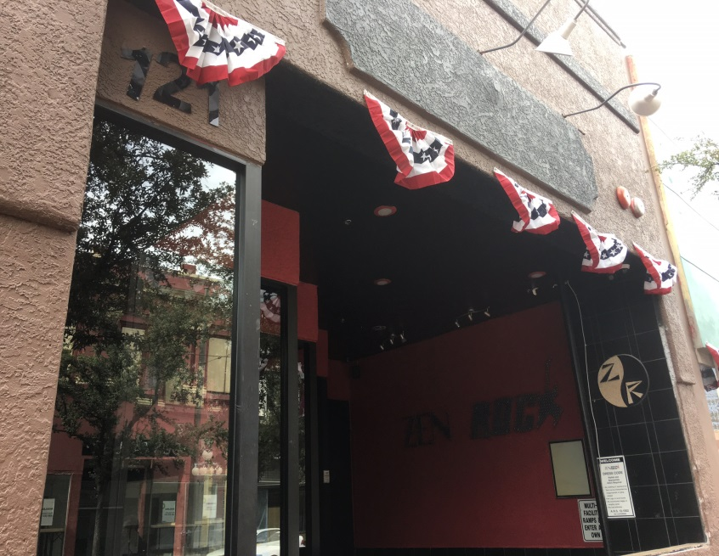
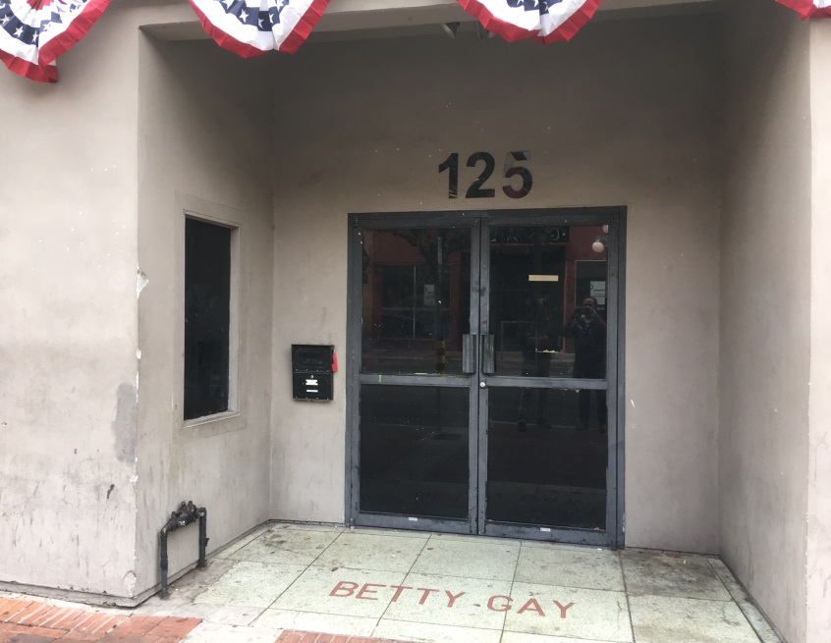
121 AND 125 E. Congress Today
121 STATUS: AGED OPERATION IN NEED OF RESTORATION | APPROX. 8000 SQ. FEET
125 STATUS: VACANT FOR YEARS AND DECAYING | APPROX. 2800 SQ. FEET
© 2017, FLORES CONCEPTS, LLC

Slide 6
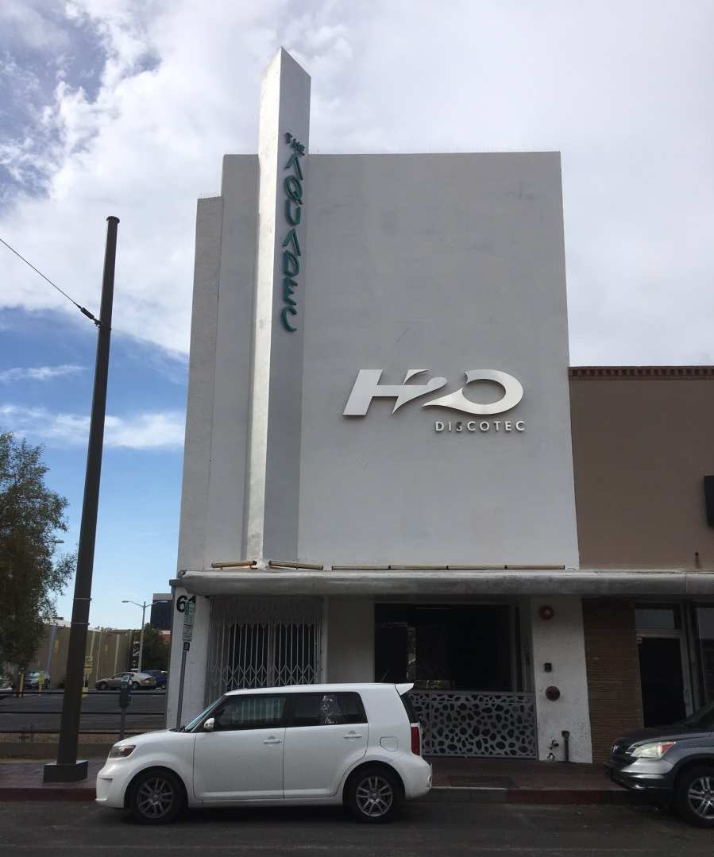
61 E. Congress Today
APPROX SQ. FOOTAGE: 6000 SQ. FT WITHOUT ROOF DECK
STATUS: NO LONGER OPEN FOR REGULAR BUSINESS HOURS
CURRENTLY ONLY OPERATING DURING SPORADIC EVENT RENTALS
© 2017, FLORES CONCEPTS, LLC

Slide 7
Clubs On Congress Restoration
Flores Concepts Will Engage in Market Research & SWOT Analysis
Re-Concept Locations & Develop New Business
New Interior & Exterior Treatments
New Branding & Signage
Install Full Service Catering and Corporate Event Programming
Develop New Marketing Plans
Build Community Programs To Drive Brand Awareness & Affinity
Establish Re-Launch Plans Around Key Dates
Focus Business Efforts on Sales Growth, Innovation, Safety & Compliance for Local and State Laws and Community Standards
Develop Enduring Brands That Create Jobs & Infrastructure
© 2017, FLORES CONCEPTS, LLC

Slide 8
Sales and Sales Tax Review 61 E. Congress 121 E. Congress 125 E. Congress
© 2017, FLORES CONCEPTS, LLC

Slide 9
61, 121, & 125 E. Congress Sales Tax Study 3 Year Sales Tax Summary 2014-2016
2014 61 E. : $46,587.70 121 E. : $86,271.61 125 E. : N/A* TOTAL: $132,859.31 | 2015 61 E. : $28,235.12 121 E. : $56,297.46 125 E. : N/A* 2015 TOTAL: $84,532.58 | 2016 61 E. : $3,554.29 121 E. : $46,990.90 125 E. : N/A* 2016 TOTAL: $50,545.19
Summary: Approx. 62% Decline In Three Years
*NOTE: 125 E. CONGRESS (FORMERLY THE BETTY GAY SHOP)
HAS BEEN NON-OPERATIONAL FOR MANY YEARS
© 2017, FLORES CONCEPTS, LLC

Slide 10
2018 Sales & Sales Tax Projections*
61 E. CONGRESS: SALES: $750,000* SALES TAX: $64,500* | 121 E. CONGRESS SALES: $1,400,000* SALES TAX: $120,400* | 125 E. CONGRESS SALES: $350,000* SALES TAX: $30,100*
2018 COMBINED SALES: $2,500,000*
2018 SALES TAX: $215,000*
12% GROWTH PROJECTED PER ANNUM *:
2019 COMBINED SALES: $2,800,000*
2019 COMBINED SALES TAX: $240,800*
2020 COMBINED SALES: $3,136,000*
2020 COMBINED SALES TAX: $269,696*
^{* APPROXIMATED PROJECTIONS}
© 2017, FLORES CONCEPTS, LLC

Slide 11
61, 121, & 125 E. Congress Sales Tax History & Projection* 2014-2016 & 2018-2020*
© 2017, FLORES CONCEPTS, LLC

Slide 12
Contact: Ray Flores ray@floresconcepts.com 520-907-1329
Thank You
CONFIDENTIAL REVIEW
© 2017, FLORES CONCEPTS, LLC

