Slide 1
Convention Center Hotel Renovation
AUGUST 22, 2017
CONFIDENTIAL REVIEW

Slide 2
What does HSL Do?
HSL Properties was founded in 1975, we are the largest owner operated property management company in Tucson.
*We have over10,000+ Apartment homes
*And1,600+ Hotel rooms in Tucson

Slide 3
EXECUTIVE SUMMARY
The existing hotel is a 155,179 square-foot full-service facility
The redeveloped hotel will be affiliated with Hilton Hotels
The redeveloped hotel will be managed by a third party (Nationally recognized company)
The property is expected to reopen in 2019
The hotel will feature 309 total guest rooms, a three-meal restaurant, a signature restaurant, a lobby bar and lounge, a gift shop and over 30,000 square feet of meeting and convention space
Projected renovations cost of $20 million

Slide 4
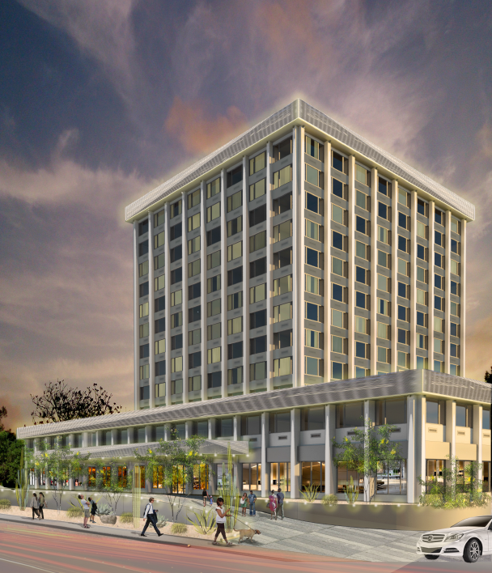
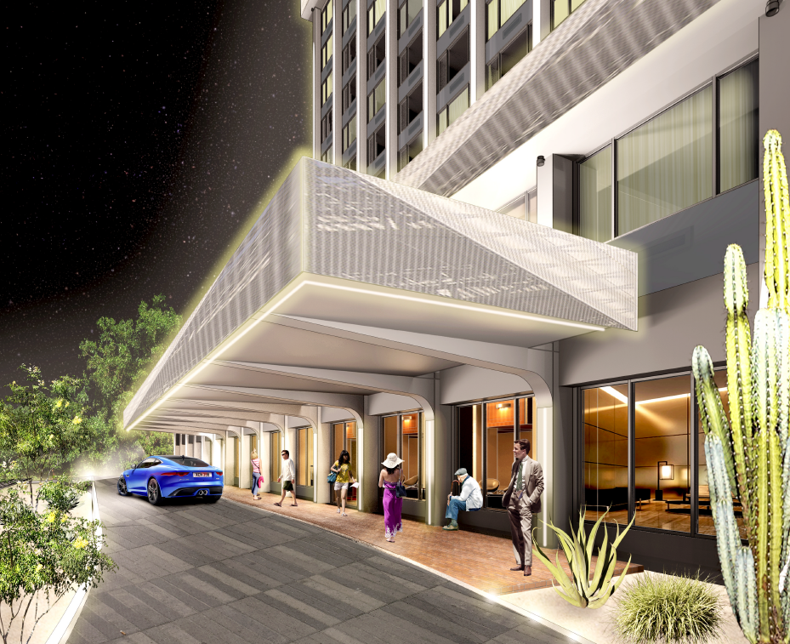

Slide 6
INDUCED DEMAND ANALYSIS –TUCSON CONVENTION CENTER
Tucson Convention Center vs. Regional Competitors
Tucson Convention Center – Historical Demand
Tucson Convention Center – Projected Room Nights

Slide 7
Tucson Convention Center vs. Regional Competitors
Name of Venue | Location | Total Function Space
Tucson Convention Center | Tucson, AZ | 145,524
Albuquerque Convention Center | Albuquerque, NM | 238,205
Palm Springs Convention Center | Palm Springs, CA | 132,190
Fresno Convention Center | Fresno, CA | 123,738
*Based on HVS Economic Impact Study

Slide 8
Tucson Convention Center – Historical Demand
 | 2013 | 2014 | 2015 | 2016
Total Attendance | 494,700 | 410,300 | 438,400 | 521,900
*Based on HVS Economic Impact Study

Slide 9
Tucson Convention Center – Projected Room Nights
 | Historical | 2019 | 2020 | 2021
Totals | 105,100 | 109,900 | 112,600 | 115,200
*Based on HVS Economic Impact Study

Slide 10
Estimated Annual economic impact (2017 Dollars)
Spending Estimates
Net Direct | $7,100,00
Indirect | $2,000,000
Induced | $1,900,000
 | $10,900,000*
*Based on HVS Economic Impact Study

Slide 11
our AsK:
No Cash
GPLET (For a TBD period up to 25 Years)
Rio Nuevo’s – District’s share of site specific taxes through 2025

